Slide 1

Blind Searches fundamentals of AI(comp1037)
Dr Qian Zhang
University of Nottingham, Ningbo China 2024

Slide 2
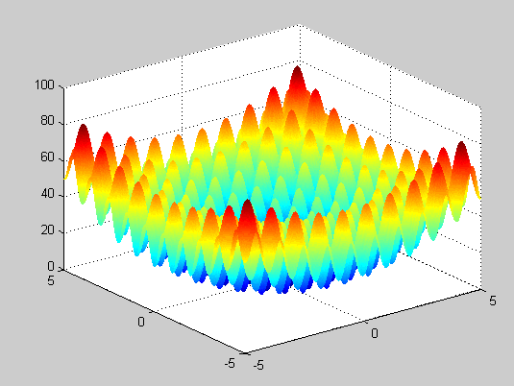

How Good is a search strategy?
Does our search method actually find a solution?
if a goal exists then the search will always find it
if no goal exists then the search will eventually finish and be able to say for sure that no goal exists
Is it a good solution (optimal) ?
Path Cost
What is the search cost ?
Time
Memory

Slide 3
Evaluation criteria
Strategies are evaluated along the following dimensions:
completeness—does it always find a solution if one exists?
time complexity—number of nodes generated/expanded
space complexity—maximum number of nodes in memory
optimality—does it always find a least-cost solution?
Time and space complexity are measured in terms of
b—maximum branching factor of the search tree
d—depth of the least-cost solution
m—maximum depth of the state space (may be ∞)
F
B
C
H
E
G
A
I

Slide 4
Search Strategies
Two Categories of Strategies
Uninformed/Blind Search
No additional information about states beyond that provided in the problem definition
Informed/Heuristic Search
Uses strategies that know whether one state is more promising than the others in reaching the goal

Slide 5
Blind Searches - implementation
Fundamental actions (operators):
“Expand”
Ask a node for its children
“Test”
Test a node to see whether it is a goal
F
B
C
H
E
G
A
I

Slide 6
General Tree Search
Function General-Search(p, QUEUING-FN) returns a solution or failure
frontier = Make-Queue(Make-Node(Initial-State[p]))
Loop do
If frontier is empty then return failure
node = Remove-Front(frontier)
If Goal-Test[p] on State(node) succeeds then return node
frontier = QUEUING-FN(frontier, (Expand(node, Actions[p]))
End

Slide 7
Breadth First Search (BFS)

Slide 8
BFS - Method
Expand shallowest unexpanded node
Expand Root Node First
Expand all nodes at level 1 before expanding level 2
…
Expand all nodes at level d before expanding nodes at level d+1
Queuing function: adds nodes to the end of the queue (FIFO)
General-Search(problem, ENQUEUE-AT-END)

Slide 9
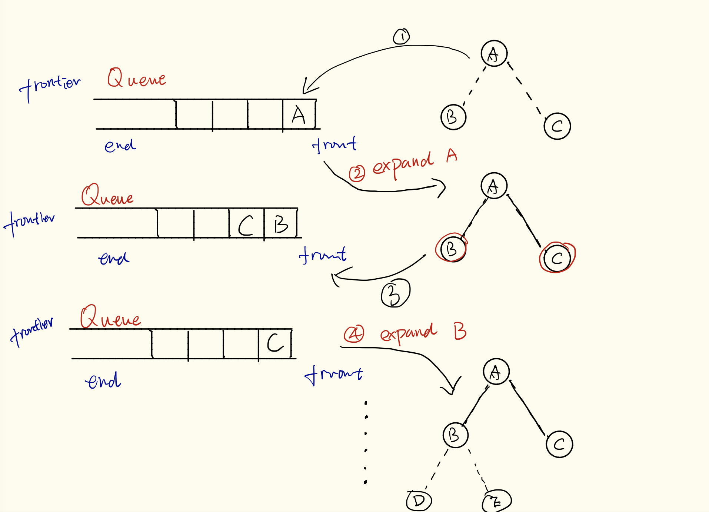

Slide 10
BFS - Implementation
A
B
C
C
C
E
D
E
F
G
B
G
D
E
D
A
D
F
E
node = Remove-Front(frontier)
If Goal-Test[p] on State(node) succeeds
then return node
frontier = ENQUEUE-AT-END(frontier, Expand(node, Actions[p]))

Slide 11
Searches - implementation
Three types of nodes during the search in tree search
Frontier nodes (open nodes, leaves)
have been discovered
have not yet been processed
Children not yet explored;
not yet tested if they are goal
Visited nodes (closed nodes)
have been discovered
have been processed
Children explored; tested if they match a goal
Undiscovered nodes
have not yet been discovered
B
C
D
E

Slide 12
The example node set
Initial state
A
A
B
C
D
E
F
Goal state
G
H
I
J
K
L
L
M
N
O
P
Q
R
S
T
U
V
W
X
Y
Z
Press space to see a BFS of the example node set

Slide 13
This node is then expanded to reveal further (unexpanded) nodes. Press space
Node A is removed from the queue. Each revealed node is added to the END of the queue. Press space to continue the search.
Node B is expanded then removed from the queue. The revealed nodes are added to the END of the queue. Press space.
We begin with our initial state: the node labeled A. Press space to continue
We then backtrack to expand node C, and the process continues. Press space
The search then moves to the first node in the queue. Press space to continue.
A
A
B
B
C
C
D
D
E
E
F
F
G
G
H
H
I
I
J
J
K
K
L
L
L
L
L
L
M
N
O
P
Node L is located and the search returns a solution. Press space to end.
Q
R
S
T
U
Press space to begin the search
Press space to continue the search
Press space to continue the search
Press space to continue the search
Press space to continue the search
Press space to continue the search
Press space to continue the search
Press space to continue the search
Press space to continue the search
Press space to continue the search
Size of Queue: 0
Size of Queue: 1
Size of Queue: 5
Size of Queue: 6
Size of Queue: 7
Size of Queue: 8
Size of Queue: 9
Size of Queue: 10
Size of Queue: 0
Queue: Empty
Queue: A
Queue: B, C, D, E, F
Queue: C, D, E, F, G, H
Queue: D, E, F, G, H, I, J
Queue: E, F, G, H, I, J, K, L
Queue: F, G, H, I, J, K, L, M, N
Queue: G, H, I, J, K, L, M, N, O, P
Queue: H, I, J, K, L, M, N, O, P, Q
Queue: I, J, K, L, M, N, O, P, Q, R
Queue: J, K, L, M, N, O, P, Q, R, S
Queue: K, L, M, N, O, P, Q, R, S, T
Queue: L, M, N, O, P, Q, R, S, T, U
Queue: Empty
Nodes expanded: 0
Nodes expanded: 1
Nodes expanded: 2
Nodes expanded: 3
Nodes expanded: 4
Nodes expanded: 5
Nodes expanded: 6
Nodes expanded: 7
Nodes expanded: 8
Nodes expanded: 9
Nodes expanded: 10
Nodes expanded: 11
Current Action:
Current Action: Expanding
Current Action: Backtracking
Current Action: Expanding
Current Action: Backtracking
Current Action: Expanding
Current Action: Backtracking
Current Action: Expanding
Current Action: Backtracking
Current Action: Expanding
Current Action: Backtracking
Current Action: Expanding
Current Action: Backtracking
Current Action: Expanding
Current Action: Backtracking
Current Action: Expanding
Current Action: Backtracking
Current Action: Expanding
Current Action: Backtracking
Current Action: Expanding
Current Action: Backtracking
FINISHED SEARCH
Current level: n/a
Current level: 0
Current level: 1
Current level: 0
Current level: 1
Current level: 0
Current level: 1
Current level: 0
Current level: 1
Current level: 0
Current level: 1
Current level: 0
Current level: 1
Current level: 2
Current level: 1
Current level: 2
Current level: 1
Current level: 0
Current level: 1
Current level: 2
Current level: 1
Current level: 2
Current level: 1
Current level: 0
Current level: 1
Current level: 2
Current level: 1
Current level: 2
Breadth-First Search Pattern

Slide 14
Evaluating a Search
We’ll evaluate all the tree search techniques w.r.t the below 4 criteria
1. Completeness
Guaranteed to find a solution if one exist?
2. Time Complexity
How long does it take to find a solution?
3. Space Complexity
How much memory required to perform the search?
4. Optimality
Find the optimal solution (one or all optimal solutions)?

Slide 15
Evaluating BFS
Evaluating against four criteria
Optimal
yes
Complete
yes
Time complexity
O(b^{d})
Space complexity
O(b^{d})

Slide 16
Evaluating BFS
D
E
F
G
Space Complexity
O(b^{d}) i.e. number of leaves at dth depth
Time Complexity
O(b^{d}) i.e. total number of nodes in the tree
b: the maximum branching factor
d: is the depth of the search tree
The space / time complexity could be less as the solution may be found before the dth level.
Big O: notation in complexity theory. We use it to measure how the problem size affects the algorithm’s computational resource (time or memory).
D
E
F
G
Notes:
The reason why time complexity is O(b^{d}) :
In a full tree with branch factor \( b \) and depth \( d \), the number of leaves (the nodes at the deepest level) is given by the formula \( b^d \), since every node at the depth \( d-1 \) has exactly \( b \) children, and there are no further levels beyond depth \( d \).
The Big O notation \( O(b^d) \) for the number of leaves indicates the upper bound for the growth rate of the number of leaves as the depth \( d \) increases. As the depth of the tree grows, the number of leaves grows exponentially, since each additional level multiplies the number of leaves by the branch factor \( b \).
When using Big O notation, we're often interested in the most significant factor that determines the growth of the function as the input becomes very large. In this case, as \( d \) increases, the term \( b^d \) will overwhelmingly be the largest term in the total count of nodes, to the point where other factors (like the number of internal nodes) become insignificant in comparison.
Therefore, even though the total number of nodes in the tree is given by \( \frac{1 - b^{d+1}}{1 - b} \) if \( b \neq 1 \), when we are talking about the complexity in terms of Big O notation with respect to the number of leaves, we refer to it as \( O(b^d) \) since this is the dominant term that dictates the complexity, especially as \( d \) gets very large.

Slide 17
Exponential Growth
Combinatorial explosion!
Combinatorial explosion: the number of problem solutions grows exponentially with its size
Time and memory requirements for breadth-first search, assuming a branching factor of 10, memory of 100 bytes per node and searching 1000 nodes/second

Slide 18
Depth First Search

Slide 19
General Tree Search
Function General-Search(p, QUEUING-FN) returns a solution or failure
frontier = Make-Queue(Make-Node(Initial-State[p]))
Loop do
If frontier is empty then return failure
node = Remove-Front(frontier)
If Goal-Test[p] on State(node) succeeds then return node
frontier = QUEUING-FN(frontier, (Expand(node, Actions[p]))
End

Slide 20
Depth First Search - Method
Expand Root Node First
Explore one branch before exploring another branch
Queuing function: adds nodes to the front of the queue (LIFO)
General-Search(problem, ENQUEUE-AT-FRONT)

Slide 21
Depth-First Strategy
1
2
3
Frontier = (1)
4
5
6
7
8
9
10
11
12
13
EXPLORED =

Slide 22
Depth-First Strategy
1
2
3
Frontier = (2, 3)
4
5
6
7
8
9
10
11
12
13
EXPLORED = (1)

Slide 23
Depth-First Strategy
1
2
3
Frontier = (4, 5, 3)
4
5
6
7
8
9
10
11
12
13
EXPLORED = (1, 2)

Slide 24
Depth-First Strategy
1
2
3
Frontier = (8, 9, 5, 3)
4
5
6
7
8
9
10
11
12
13
EXPLORED = (1, 2, 4)

Slide 25
Depth-First Strategy
1
2
3
Frontier = (9, 5, 3)
4
5
6
7
8
9
10
11
12
13
EXPLORED = (1, 2, 4, 8)

Slide 26
Depth-First Strategy
1
2
3
Frontier = (5, 3)
4
5
6
7
8
9
10
11
12
13
EXPLORED = (1, 2, 4, 8, 9)

Slide 27
Depth-First Strategy
1
2
3
Frontier = (10, 11, 3)
4
5
6
7
8
9
10
11
12
13
EXPLORED = (1, 2, 4, 8, 9, 5)

Slide 28
Depth-First Strategy
1
2
3
Frontier = (11, 3)
4
5
6
7
8
9
10
11
12
13
EXPLORED = (1, 2, 4, 8, 9, 5, 10)

Slide 29
Depth-First Strategy
1
2
3
Frontier = (3)
4
5
6
7
8
9
10
11
12
13
EXPLORED = (1, 2, 4, 8, 9, 5, 10, 11)

Slide 30
Depth-First Strategy
1
2
3
Frontier = (6, 7)
4
5
6
7
8
9
10
11
12
13
EXPLORED = (1, 2, 4, 8, 9, 5, 10, 11, 3)

Slide 31
Depth-First Strategy
1
2
3
Frontier = (12, 13, 7)
4
5
6
7
8
9
10
11
12
13
EXPLORED = (1, 2, 4, 8, 9, 5, 10, 11, 3, 6)

Slide 32
Depth-First Strategy
1
2
3
Frontier = (13, 7)
4
5
6
7
8
9
10
11
12
13
EXPLORED = (1, 2, 4, 8, 9, 5, 10, 11, 3, 6, 12)

Slide 33
Depth-First Strategy
1
2
3
Frontier = (7)
4
5
6
7
8
9
10
11
12
13
EXPLORED = (1, 2, 4, 8, 9, 5, 10, 11, 3, 6, 12, 13)

Slide 34
Depth First Search – evaluation
Space complexity
Store: the path from the root to the leaf node as well as the unexpanded neighbour nodes
DFS requires storage of O(bm) nodes
b: a branching factor
m: maximum depth
Time complexity
O(b^{m}) in the worst case
Notes:
Number of nodes in the frontier = (b-1)*m => ignore constant item => O(bm)

Slide 35
Depth First Search – evaluation
Completeness
No: An infinite branch: never terminate => no goal state exist in that branch ?
Optimality
No: Finds a solution: is there a better solution at a lower level?
DFS: neither complete nor optimal
Notes:
https://www.youtube.com/watch?v=sVcB8vUFlmU

Slide 36
Map of Romania
Odarea
Neamt
Zerind
Iasi
Arad
Sibiu
Fagaras
Vaslui
Timisoara
Rimnicu Vilcea
Urziceni
Lugoj
Pitesti
Hirsova
Mehadia
Bucharest
Dobreta
Eforie
Craiova
Giurgui

Slide 37
Uniform Cost Search (ucs vs. BFS)

Slide 38
Uniform Cost Search (vs. BFS)
 | Optimal condition | Order of nodes explored
BFS | Same cost for all branches | Shallower nodes first
UCS | Cost never decreases | Lowest cost node first
Path Cost: total cost of the path from the root to node
UCS: always remove the smallest cost node first
Sort the queue in an increasing order, or
Search the queue and remove the node of smallest cost
Function UCS(problem) returns a solution or failure
Return General-Search(problem, ENQUEUE-BY-COST)
Notes:
Storing the frontier as a priority queue ordered by g

Slide 39
UCS - Example
A
1
10
5
B
5
S
G
15
5
C
BFS: finds the path SAG, of a cost of 11
UCS: finds the cheaper solution (SBG). It will find SAG but will not see it as it is not at the head (cheapest) of the queue

Slide 40
Node A is removed from the queue and the revealed node (node G) is added to the queue. The queue is again sorted on path cost. Note, we have now found a goal state but do not recognise it as it is not at the front of the queue. Node B is the cheaper node. Press space.
Node S is removed from the queue and the revealed nodes are added to the queue. The queue is then sorted on path cost. Nodes with cheaper path cost have priority.In this case the queue will be Node A (1), node B (5), followed by node C (15). Press space.
Once node B has been expanded it is removed from the queue and the revealed node (node G) is added. The queue is again sorted on path cost. Note, node G now appears in the queue twice, once as G10 and once as G11. As G10 is at the front of the queue, we now proceed to goal state. Press space.
We now expand the node at the front of the queue, node A. Press space to continue.
We start with our initial state and expand it…
A
A
1
10
5
5
S
S
B
B
G
G
G
G
G
G
The goal state is achieved and the path S-B-G is returned. In relation to path cost, UCS has found the optimal route. Press space to end.
15
C
Press space to begin the search
Size of Queue: 0
Size of Queue: 1
Size of Queue: 3
Size of Queue: 0
Queue: Empty
Queue: S
Queue: A, B, C
Queue: B, G11, C
Queue: G10, G11, C15
Queue: Empty
Nodes expanded: 0
Nodes expanded: 1
Nodes expanded: 2
Nodes expanded: 3
Current action: Waiting….
Current action: Expanding
Current action: Backtracking
Current action: Expanding
FINISHED SEARCH
Current level: n/a
Current level: 0
Current level: 1
Current level: 0
Current level: 1
Current level: 2
UNIFORM COST SEARCH PATTERN

Slide 41
UCS vs. BFS – evaluation
 | Optimality | Completeness
BFS | Only if the branch costs are the same | Systematically search the whole tree (in the worst case)
UCS | Even branch costs are different
 | Time complexity | Space complexity
BFS & UCS | b^{d} | b^{d}
UCS = BFS
When all branches have the same cost
We are talking about the worst case scenario
UCS is usually better than BFS

Slide 42
Blind Searches – summary
b = Average branching factor
d = Depth of solution
m = Maximum depth of the search tree

Slide 43
Blind (Uninformed) Searches
Simply searches the State Space
No preference as to which node to expand next
The different blind search algorithms
Characterised by the order which expands the nodes
Different node orderings: shape of the frontier
Different shapes of the frontier: very different memory usages
An uninformed search
Has no knowledge about its domain

Slide 44
Blind Searches – summary
Blind searches (Chapter 4.1-4.3 AIMA (solving problem by searching))
Breadth first
Depth first
Uniform cost search (vs. BFS)
Against the four evaluation criteria
Know how to define a search problem
Know how to implement UCS (in the lab)

